Slide 1


Artificial Doorman
by Maram Salameh & Andrew Kreidle

Slide 2
Problem Statement
Our project proposes to introduced an innovative, affordable and easy to manage security system that sends alerts via text message/email to the user’s cellphone or computer, and a locking mechanism that can be controlled remotely.

Slide 3
Comparison
 | Artificial Doorman | Schlage Nexia | Ring Video Doorbell
Cost | less than $250 **no additional fees | $300 *plus additional $9.99 monthly fees | $250 *plus additional monthly fees
Protocol | WiFi | Z-Wave | WiFi
Video | ✗ | ✗ | ✔
Picture Snapshots | ✔ | ✗ | ✗
Text Message Alerts | ✔ | ✔ | ✗
Email Alerts | ✔ | ✔ | ✗
Remote locking | ✔ | ✗ | ✗
Motion sensing | ✔ | ✗ | ✔
Mobile App | ✗ | ✗ | ✔

Slide 4
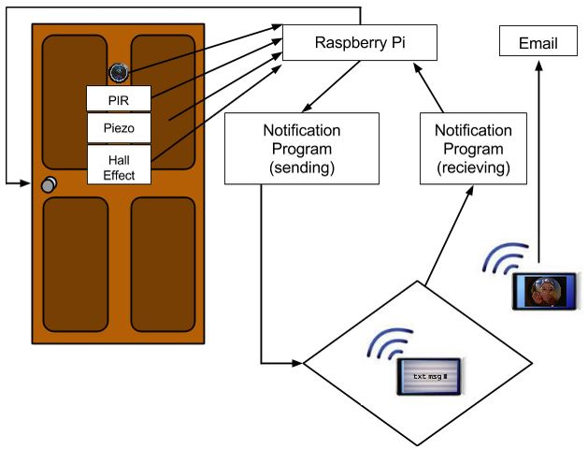

Slide 5
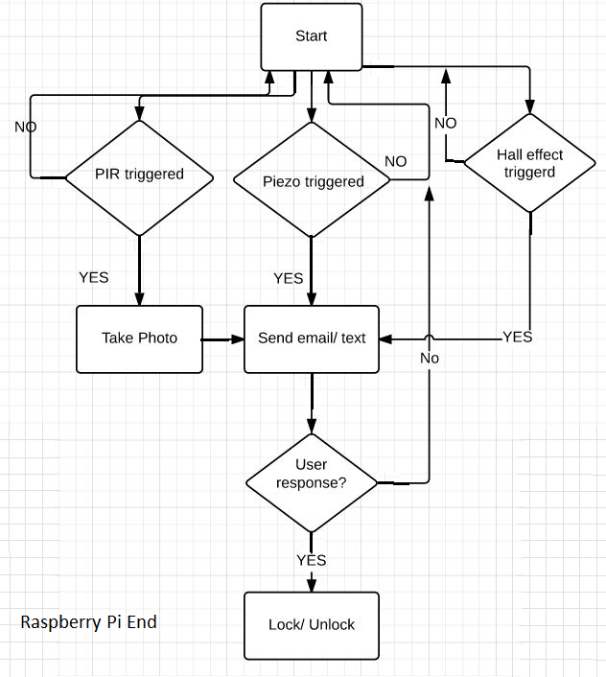

Slide 6
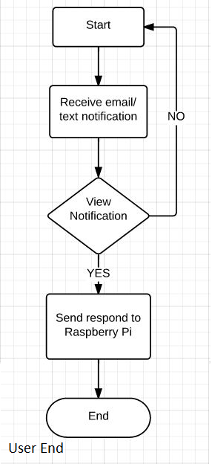

Slide 7
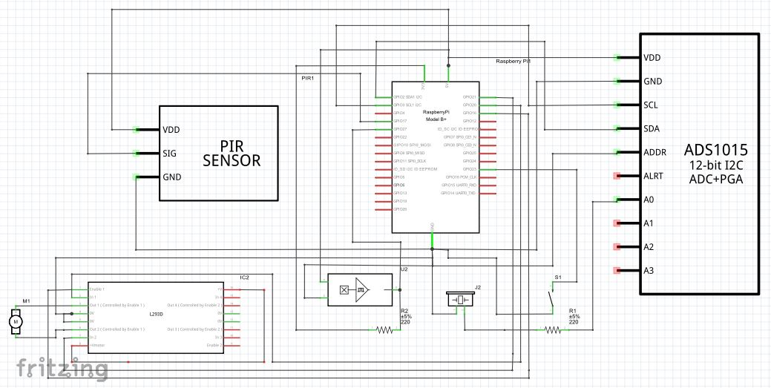

Slide 8
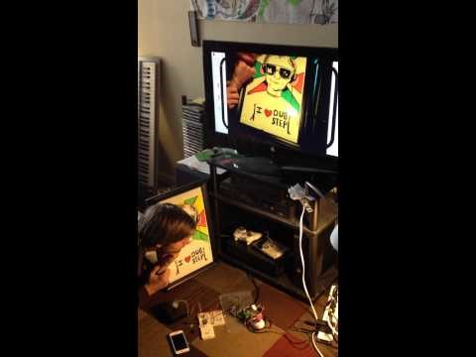
Test Results
Motion Triggered Picture Notification

Slide 9
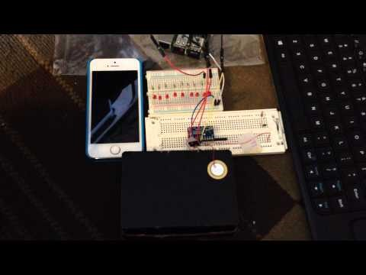
Knock alerts

Slide 10
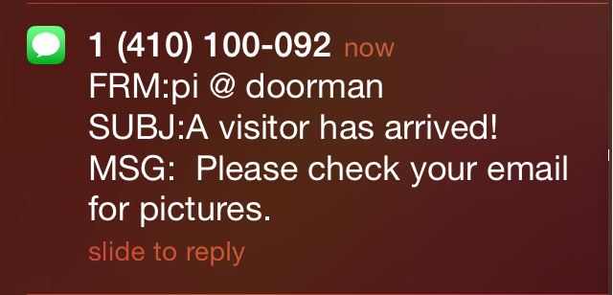
Guest/Breach Alert System

Slide 11
Software
Mutt
Python GPIO libraries
I2C libraries

Slide 12
Most challenging aspect
SSU network
I2C doesn’t work if camera is enabled
Camera disables itself randomly
PIR sensitivity

Slide 13
Learning Experience

Slide 14
Publications & Presentation:
Received IRA Grant Funds
$ 500
SSU Science Symposium

Slide 15
Future Work
Implement more sensors
Video taking and streaming
Create user friendly application

Slide 16
Faculty Advisor
Professor Jack Ou
PHD, MS, and BS at Rutgers University
Interests: RF and analog CMOS

Slide 17
Corporate Sponsor
Digilock
Ben Valdovinos
SSU Alumni
Electrical Engineer at Security People, Inc. dba: Digilock

Slide 18
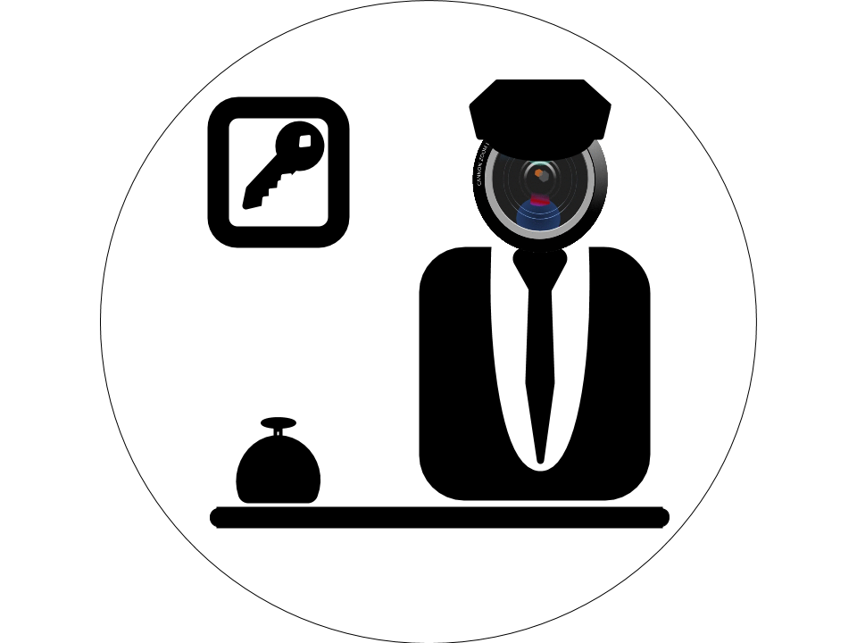
Artificial Doorman
Maram Salameh & Andrew Kreidle
Artificial Doorman web page

